Slide 1
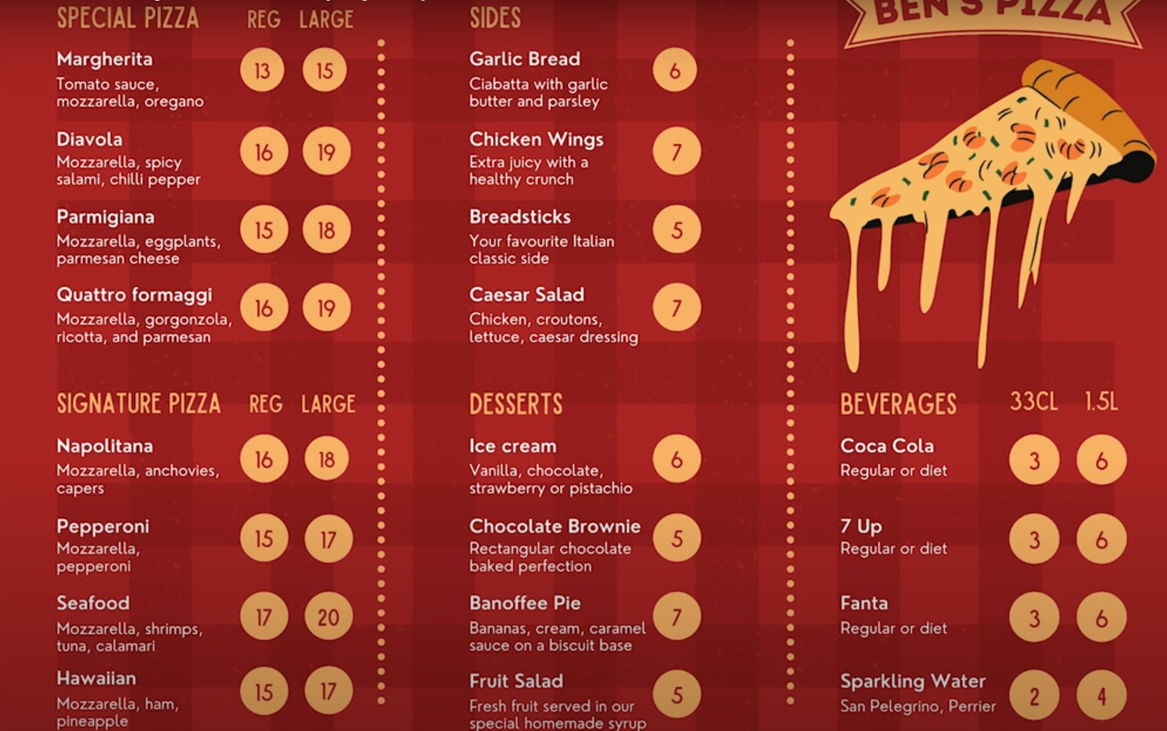
Ben’s Pizza Shop: Database Design and Visualization
An End-to-End Data
Management
Solution

Slide 2
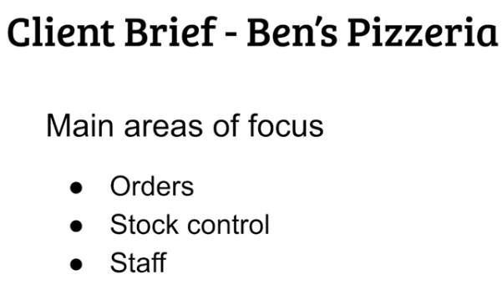
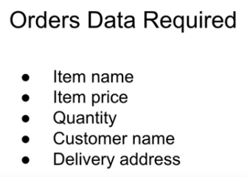
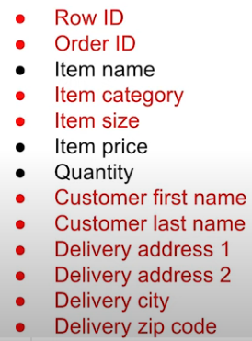
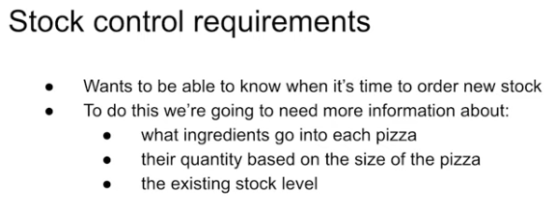
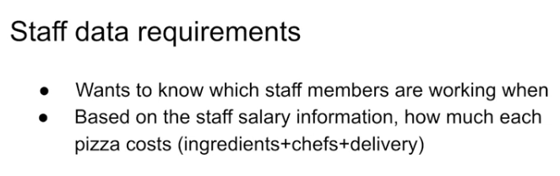
Business Requirements
More Columns and tables are added using data normalization techniques and database design knowledge

Slide 3
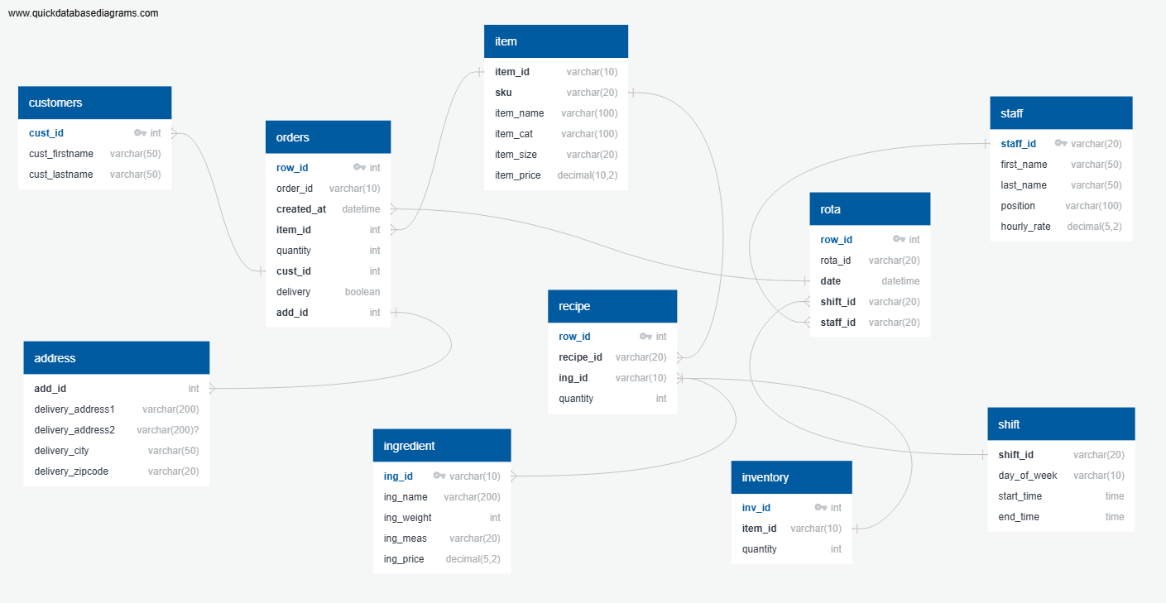
Final Database Design
Additional columns and tables are added using normalization techniques to make the database more efficient

Slide 4
Implementation in Google Cloud
Create a bucket to store data files.
Run SQL queries in Google Cloud MySQL Studio.
Create views for dashboards.
Create a MySQL instance in Google Cloud.
Summary of Advanced SQL Concepts Used:
Joins: LEFT JOIN to combine data from multiple tables.
Subqueries: Queries nested within other queries to perform complex calculations or aggregations.
Aggregate Functions: SUM() for summing values within groups.
Date and Time Functions: Functions like TIMEDIFF(), HOUR(), MINUTE() for manipulating and extracting time-related data.
Column Aliasing: Aliasing columns and tables (AS) for readability and to resolve naming conflicts.
Arithmetic Operations: Mathematical calculations (*, /) to derive new columns or values based on existing data.
Import tables and views.
Connect Looker Studio to the MySQL instance.
Use custom queries in Looker to extract data for visualization.

Slide 5
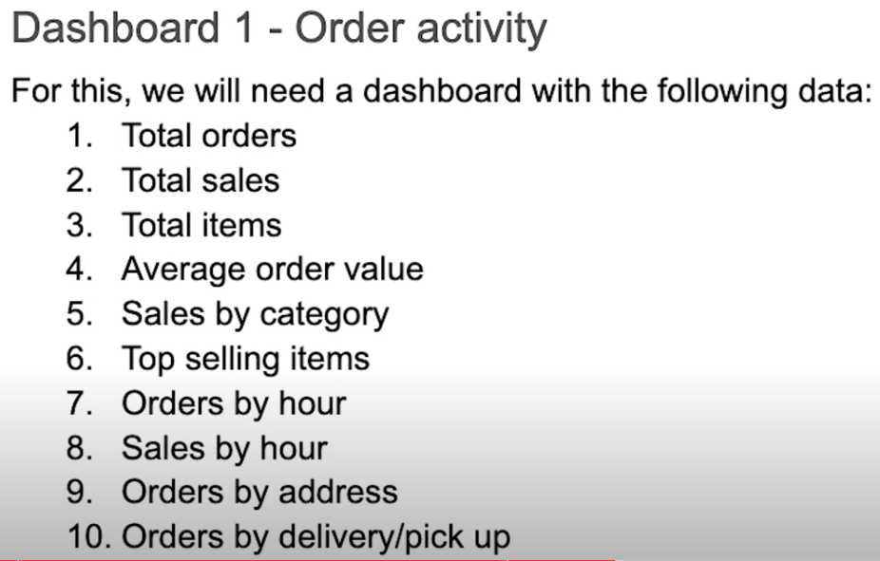
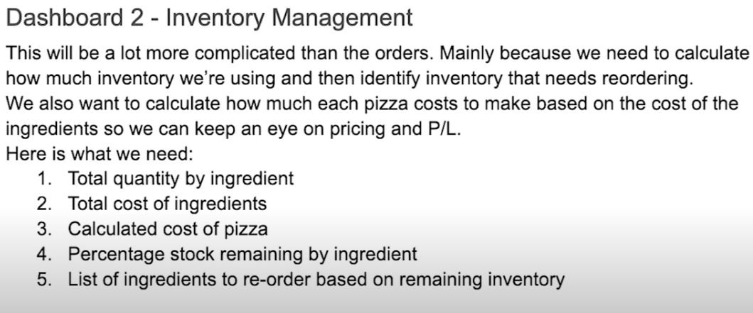
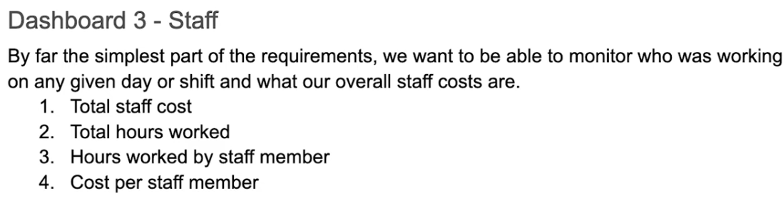
Dashboard Created based on these three Visualization Requirements

Slide 6
Looker Studio Tools and techniques used for visualization
Used for displaying total orders and total sales.
Created a new calculated field itemprice * quantity to calculate total sales.
Used to visualize sales by category, with total sales as the metric and item category as the dimension.
Displayed top selling items using total sales as the metric and item name as the dimension.
Combined orders by hour and sales by hour in a single chart, showing trends over time with two lines.
Used for orders by address, resolving issues with locations using a concatenated field that includes "United States" to differentiate.
Used to visualize orders by delivery/pickup, with delivery as the dimension and order ID as the metric.
Displayed total quantity by ingredient and total cost by ingredient, using ingredient name as the dimension and metrics for ingredient cost and ordered weight.
Applied to highlight ingredients needing reorder based on remaining inventory. Used rules to color code based on percentage remaining.
Created a calculated field recipequantity * unitcost for calculating the cost of pizza.
Combined tables visually by blending two tables into one to enhance data presentation.
Implemented data filters and date range controls to ensure data consistency and flexibility for viewers.
Created a single table for hours worked by staff members and cost per staff member, using dimensions like first name, last name, start time, end time, and metrics for hours in shift, hourly rate, and staff cost.
Calculated Fields: Used for deriving new metrics like total sales, cost of pizza, and percentage remaining.
Conditional Formatting: Applied to highlight critical insights such as ingredients needing reorder.
Blend Tables: Combined multiple tables to consolidate data views and facilitate comparison.
Google Maps Integration: Addressed geographic visualization challenges using Google Maps integration in Looker.
Data Filters and Date Range Controls: Provided interactivity and flexibility to viewers by allowing them to adjust date ranges.

Slide 8
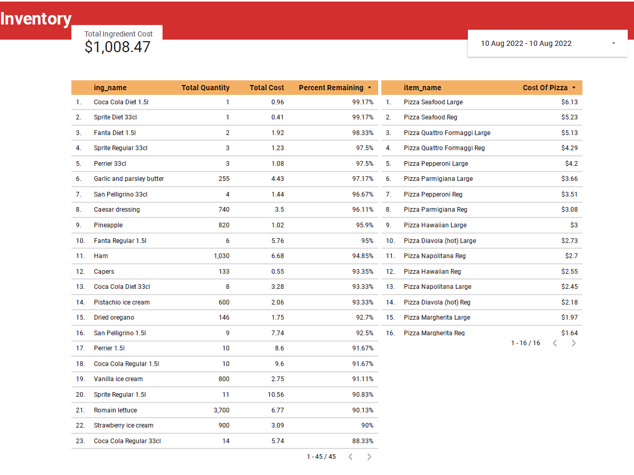

Slide 9
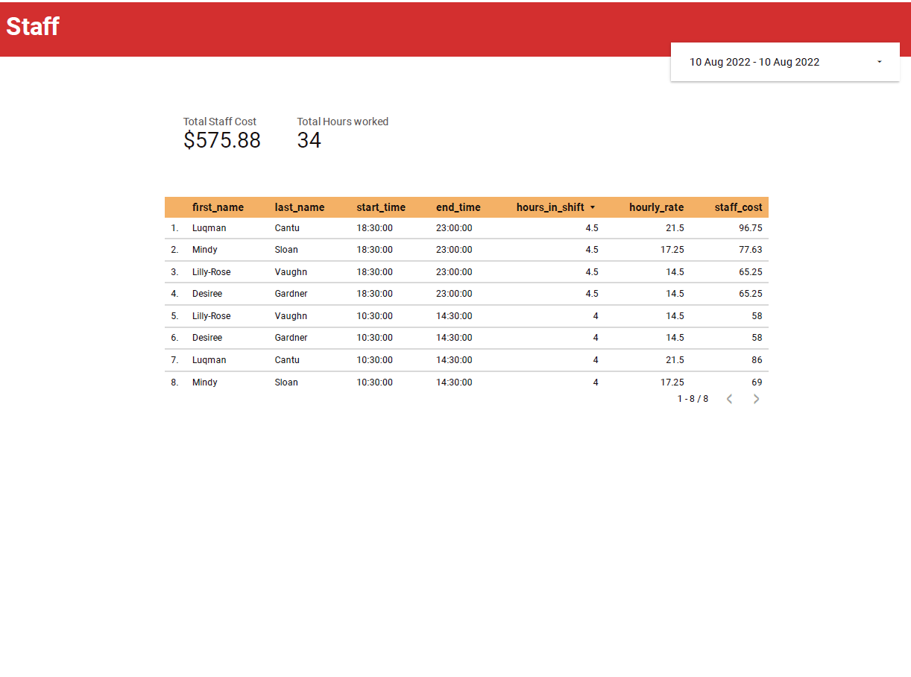

Slide 10
End Note
Efficient Data Management: By designing a relational database, we've ensured that data related to orders, stock levels, and staff management is stored efficiently, reducing redundancy and improving data integrity.
Insightful Dashboards: The dashboards created using Looker Studio provide real-time insights into critical aspects of the business:
Dashboard 1: Provides key metrics like total orders, sales, average order value, and insights into sales trends by category and time. The geographical view of orders enhances delivery logistics.
Dashboard 2: Enables effective stock management by visualizing ingredient quantities and costs and identifying items for reorder based on inventory levels. The calculated cost of pizzas helps in pricing strategies.
Dashboard 3: Facilitates workforce management by visualizing staff costs, total hours worked, and individual contributions, aiding in scheduling and cost optimization.
Data-Driven Decision Making: These visualizations empower Ben to make informed decisions regarding inventory management, pricing strategies, and staffing based on real-time data and trends.
Operational Efficiency: By automating data retrieval and visualization through Looker Studio, we've streamlined reporting processes, allowing Ben to focus more on business operations and growth strategies.
Scalability and Flexibility: The cloud-based infrastructure ensures scalability as the business grows, accommodating more data and expanding analytics capabilities seamlessly.

